Slide 1
ASP.NET Core MVC & EF Core
14-Sep-2024
-Amit Bhatte

Slide 2
Pre-requisite
HTML tags & basic JavaScript
.NET Core platform and Package manager
Modular platform
NuGet package manager
Dependency Injection
Logging
C# concepts
Datatypes & implicit types
boxing & unboxing
Notes:
https://www.tutorialsteacher.com/mvc/create-first-asp.net-mvc-application

Slide 3
ASP.NET Core MVC
ASP.NET + .NET Core + MVC
ASP.NET: Server-side framework for web development to produce dynamic pages
.NET Core: Latest Microsoft open-source platform to develop cross-platform applications.
Web applications supported by ASP.NET:
ASP.NET Web Forms
ASP.NET MVC
ASP.NET WebAPI
many more…..
Notes:
https://www.tutorialsteacher.com/mvc/create-first-asp.net-mvc-application

Slide 4
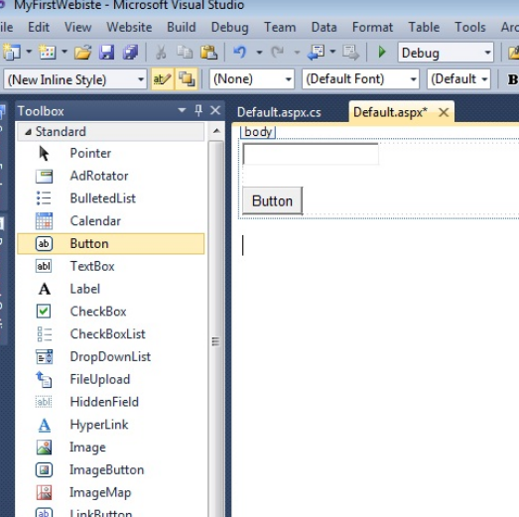
ASP.NET WebForms
ASP.NET WebForms was a popular server-side web application development option.
Microsoft RAD (Rapid Application Development) strategy.
Main challenges with ASP.NET WebForms:
Response Time
Bandwidth consumption

Slide 5
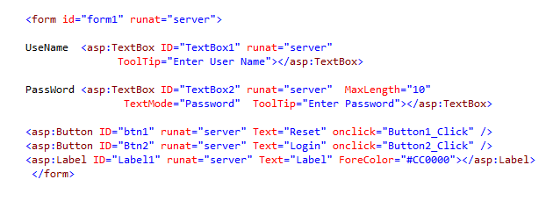
ASP.NET WebForms
Notes:
TEST NOTES

Slide 6
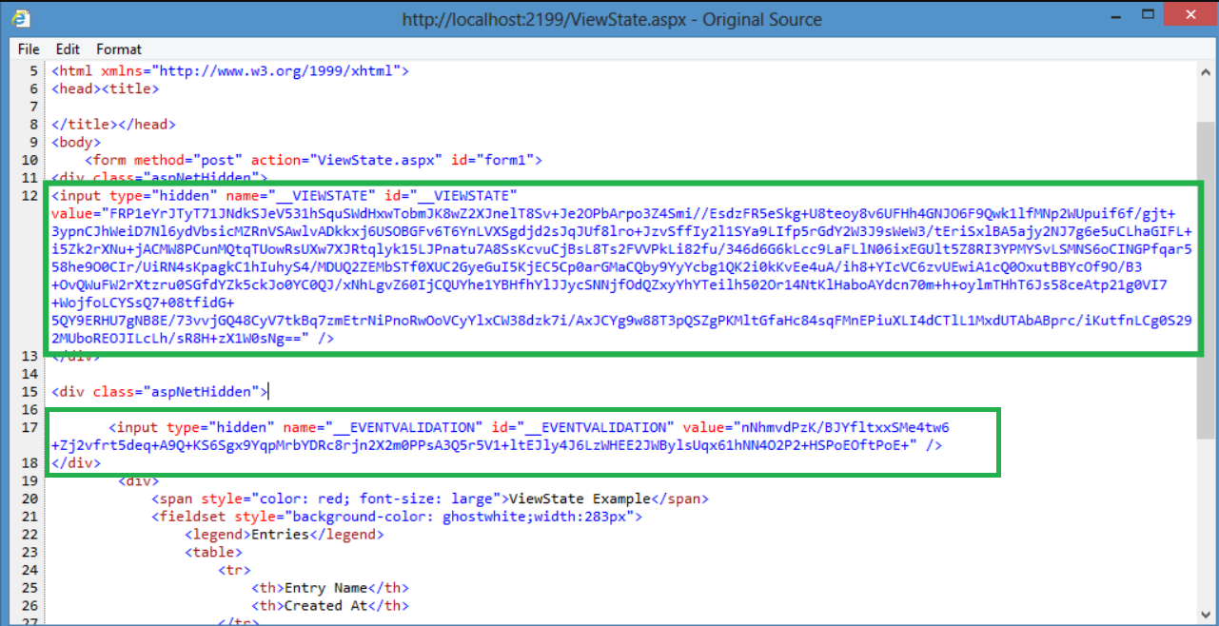
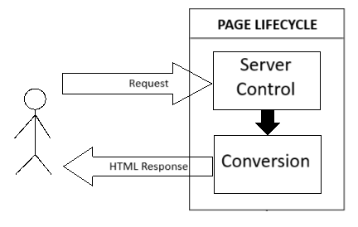

Slide 7
MVC
Get rid of un-necessary things like viewstate, event validation, etc.
Clear separation of concerns: HTML UI, code, etc.
MVC (Model-View-Controller) is an architectural design pattern that organizes an application's logic into distinct layers.
These 3 distinct layers are:
Model: A set of classes that determine the data, data structure to be worked
View: A pure HTML UI that decides how data will be displayed
Controller: A set of classes that interact with user, control over all application flow

Slide 8
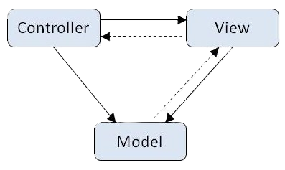
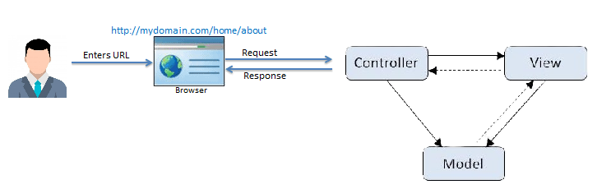

Slide 9
LAB1: Build,Run & Debug new application
Notes:
Environment setup
Folder Structure
Building, Debugging & Running MVC

Slide 10
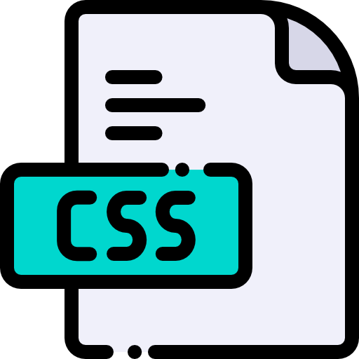
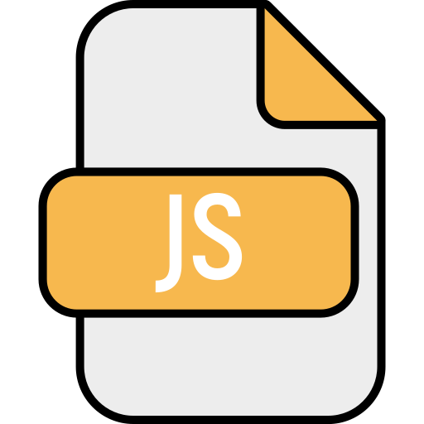


Serving static File
Static files are files that do not change on the fly like Javascript file, CSS file, image file, etc.
In ASP.NET Core MVC we place all static files inside folder ‘wwwroot’.
Request for static files are handled by special middlewares in MVC.
With middleware the order in which they are registered is very important.

Slide 11
LAB2: Serving static Files

Slide 12
Nuget & Middleware
Nuget:
Nuget is a package management system that helps developers to create, publish, consume, and share reusable code.
A package management system is a collection of software tools that automates the process of installing, upgrading, configuring, and removing software from a computer.
A package is an archival file containing sharable code as well as necessary metadata for its deployment.
Middleware is the one which decides how to responds to incoming HTTP requests.
It can also decide what needs to be done in case of an error.
Each piece of middleware in ASP.NET Core MVC is an object, and each piece has a very specific, focused, and limited role.
Hence, we need many pieces of middleware for an application to carry out different functionalities.
Middleware:

Slide 13
LAB3: My First MVC Application
NEXT
Notes:
Environment setup
Folder Structure
Building, Debugging & Running MVC

Slide 14
Controller
A Controller handles users' request and returns a response
ASP.NET Core MVC requires all controller files to end with "Controller".
A Controller is a C# class derived from the base class Controller.
Controller class contains public methods called Action methods.
Action methods need to have public scope
Action methods cannot be static and cannot be overloaded
Action methods need to return result of type ActionResult (or its sub-children)
We will look at some of the commonly used result classes in next slide.
A base controller class method is used in action method to return the actual result class.

Slide 15
Result Class | Description | Controller class method
ViewResult | Represents a HTML result | View()
EmptyResult | Represents no result | -
ContentResult | Represents a string literal as result | Content()
JsonResult | Represents a JSON result | Json()
RedirectResult | Represents a redirection to a new URL | Redirect()
RedirectToRouteResult | Represents redirection to another route. | RedirectToRoute()
Can we return native datatypes from an action method ?

Slide 16
Views
A view is an HTML template with embedded Razor markup (next slide).
A view file has .cshtml extension if the programming language is C#.
By default, MVC looks for view files in the Views folder.
View files that belong to a specific controller are stored in a sub-folder in the Views folder and that sub-folder has the same name as the controller.
By default, view file has the same name as that of the controller action method with a .cshtml extension OR we can specify the exact view name we want to invoke
If we want to reuse some views we place them under “shared” folder inside Views folder.
The views inside the “shared” folder are partial views which are accessible to all other views.

Slide 17
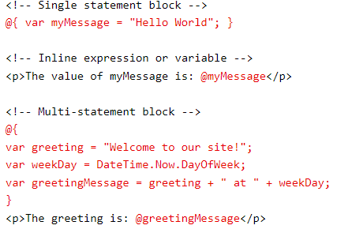
Razor (ASP.NET’s own markup language)
Inspired by HTML, ASP.NET made its own markup syntax Razor.
It lets you embed server-based code
(C# or VB) in web pages.
Syntax rules:
Case Sensitive
Code should be enclosed in @{….}
Inline variables start with @
Variables declared as ‘var’
Code statements should end with ‘;’
String must be enclosed in “”.

Slide 18
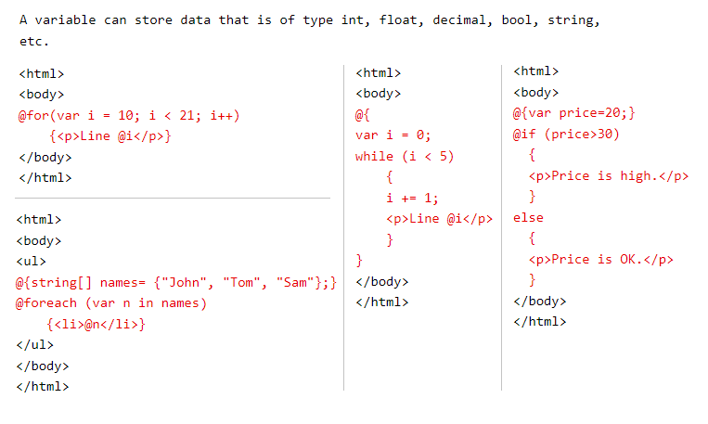

Slide 19
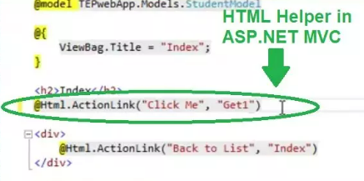
HTML Helper
HtmlHelper class renders HTML controls in a razor view.
@Html is an object of the HtmlHelper class.
HtmlHelper has many extension methods that create different HTML controls.
HtmlHelper makes it easy to bind to view data or model data.
E.G. @Html.Label(), @Html.TextBox(), etc

Slide 20
LAB4: Razor Views
Notes:
Environment setup
Folder Structure
Building, Debugging & Running MVC

Slide 21
Routing
How are we able to see particular view just by entering the URL?
ANSWER: Routing
Routing is a process of mapping the browser request to the controller & action method.
There are 2 types of routing in MVC:
Convention-based routing
Attribute routing (most commonly used)
In convention-based routing we tell MVC the url pattern and how it maps to controllers and action methods.
URL | INTERPRETATION
http://localhost:5420/user/info | /{CONTROLLER}/{ACTION}
http://localhost:5420/info/user | /{ACTION} /{CONTROLLER}
http://localhost:5420/user/details/123 | /{CONTROLLER}/{ACTION}/{ID?}
http://localhost:5420/news/topnews/ind/pune | /{CONTROLLER}/{ACTION}/{COUNTRY?}/{CITY?}

Slide 22
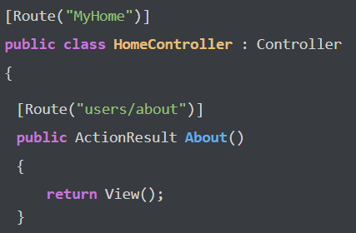
Attribute based Routing
Here we use C# attributes on our controller classes and on the action methods.
These attributes have metadata in it and are termed as Route.
Routes tell MVC application when to call a specific controller and action method.
Routes are evaluated in the order that they appear in Controller class.

Slide 23
LAB5: MVC Routing

Slide 24
ViewData & ViewBag
ViewData | ViewBag
ViewData is a dictionary of key-value pair that stores data as key-value | ViewBag is just a syntactic sugar coating over viewdata (it uses ViewData internally)
It is dictionary object | Its an object
ViewData is Faster than ViewBag | ViewBag is slower than ViewData
EXAMPLE | EXAMPLE
List<string> students = new List<string>{"Hema","Rekha","Jaya","Sushma"}; ViewData[“students”] = students | List<string> students = new List<string>{"Hema","Rekha","Jaya","Sushma"}; ViewBag.students = students;
<ul> @foreach (var student in ViewData[“students"] as List<string>) { <li>@student</li> } </ul> | <ul> @foreach (var student in ViewBag.students) { <li>@student</li> } </ul>

Slide 25
LAB6: Models & ViewData, ViewBag

Slide 26
Challenges with ViewData & ViewBag
No solid connection between data sent and data received
No type safety as no compile time error
All data is object so exclusive type-casting is required (Boxing and Unboxing in C#)
Performance degradation due to casting of value into correct types
SOLUTION: Strongly typed View

Slide 27
Strongly typed View
ViewData & ViewBag are some ways in which we can pass data from controller to view. – Loosely Typed
A strongly typed view is efficient way of passing data from controller to view
In order to create a strongly typed view we need to pass the model object as a parameter to the View() method
The cshtml view file needs to specify @model as follows:
@model StrongTypeViewDemo.Models.Employee
Properties of your model class are accessed by @Model anywhere within the view
@model != @Model

Slide 28
LAB7: Strongly typed View

Slide 29
Passing data from View to Controller
End user can send request to the server in 4 ways:
URL in address bar
Hyperlink (action tag in HTML)
Using AJAX
Using HTML <form> tag
A request sent by form tag can be of 4 types:
GET
POST
PUT
DELETE
When a request is sent to the server values of all the HTML controls are sent to server.
In case of GET,PUT & DELETE they are sent as query parameters and in case of POST they are sent as request body

Slide 30
Model Binder
HTML elements have the ‘name’ attribute
In case of POST the server distinguishes each posted value on basis of the attribute → name
Only if the elements within form have name attribute their value will get posted when submitting the form
In case of ASP.NET Core MVC Model Binder will iterate through primitive parameters of action method and try to match the name attribute of elements
If a match is found the incoming value is assigned to the parameter
In case of a user defined parameter Model Binder will iterate through each & every property and try to find match based on property name

Slide 31
LAB8: Model Binder

Slide 32
EFCore
Concept: ORM
Object-relational mapping (ORM) create a layer between the programming language and a relational database.
Main intent is to simplify interaction between relational databases and OOP languages.
ORM helps to hide complexities of your database-Encapsulation
Entity Framework Core (EFCore) is Microsoft ORM tool
In RDBMS we speak in terms of Tables & Columns whereas with ORM we speak in terms of classes, object & properties.
When we implement Entity Framework there are 3 approaches we can use for implementation

Slide 33
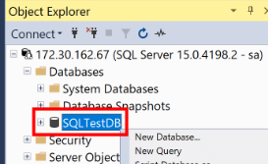
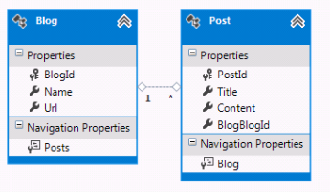
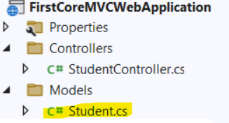
EFCore
Database First Approach | Model First Approach | Code First Approach
Create DB first and EFCore will generate model classes from it | Create Model classes and relationships in designer EFCore will generate DB tables & columns | Create POCO classes and relationships in C# code and EFCore will generate DB tables & columns
Entity Framework Core (EFCore) can be added to application by downloading & installing Nuget packages:
Microsoft.EntityFrameworkCore
Microsoft.EntityFrameworkCore.SqlServer
Microsoft.EntityFrameworkCore.Tools
What happens to .csproj?

Slide 34
LAB9: EFCore

Slide 35
Deployment & Hosting MVC Core App
Build the ASP.NET Core MVC application
Right-click the ASP.NET Core MVC application and select the option to ‘publish’
If a valid Azure subscription is available the application can be published in Azure
The application can also be published to a physical folder by selecting the ‘Folder’ option
Browse and select appropriate location on physical drive to publish the application
Click ‘Publish’ to publish the application on physical drive
Add a website in IIS as shown below to deploy the ASP.NET Core MVC application on IIS server

Slide 36
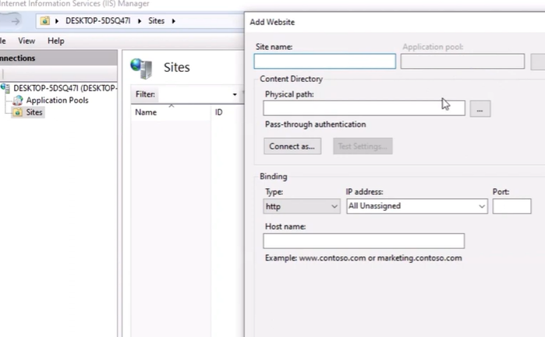

Slide 37
LAB10: Deployment & Hosting

Slide 38
Security
Cross-site scripting (XSS): Attacker injects malicious executable scripts into the code of a trusted application or website.
Cross-site request forgery (XSRF/CSRF): Attackers tricks a user into performing unintended actions on a web application that the user is authenticated to.
Example: User has logged into online banking account and an attacker sends a forged lottery email.
@using (Html.BeginForm(“changepassword", “Account", FormMethod.Post)) { @Html.AntiForgeryToken() <span>New Password:</span> @Html.TextBox(“txtPassword”) }

Slide 39
LAB10: Security in ASP.NET Core MVC

Slide 40
